Slide 1
Word Vector Model

Slide 2
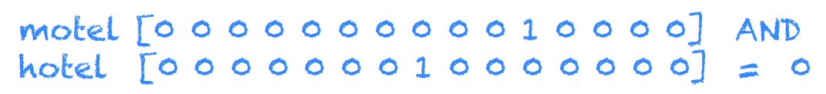
Word Representation
In general, words are treated as atomic symbols.

Slide 3
Word Vectors
At one level, it is simply a vector of weights.
In a simple 1-of-N (or ‘one-hot’) encoding every element in the vector is associated with a word in the vocabulary.
The encoding of a given word is simply the vector in which the corresponding element is set to one, and all other elements are zero.
One-hot representation:

Slide 4
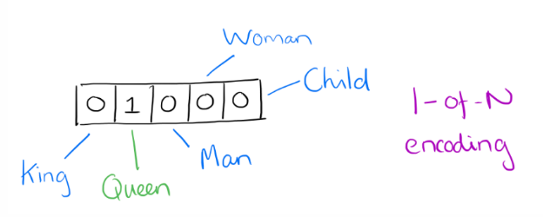
Word Vectors: One-Hot Encoding
Suppose our vocabulary has only five words: King, Queen, Man, Woman and Child.
We could encode the word ‘Queen’ as:

Slide 5
Limitations of One-hot encoding
Word vectors are not comparable
Using such an encoding, there is no meaningful comparison we can make between word vectors other than equality testing.

Slide 6
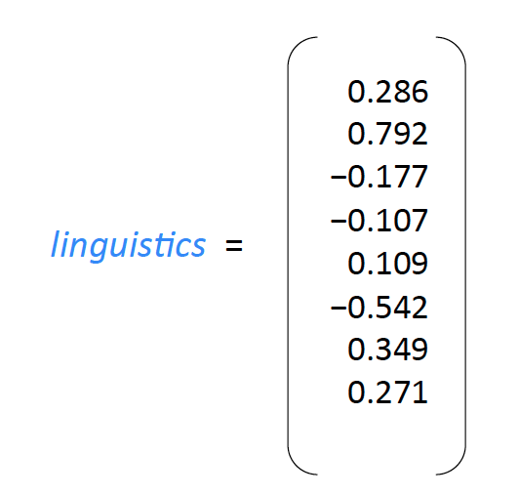
Word2Vec – A distributed representation
Distributional representation – word embedding ?
Any word w_{i} in the corpus is given a distributional representation by an embedding
w_{i} ∈ R^{d} i.e a d-dimensional vector that is learnt.
For Example:

Slide 7
Distributional Representation
Take a vector with several hundred dimensions (say 1000).
Each word is represented by a distribution of weights across those elements.
So instead of a one-to-one mapping between an element in the vector and a word, the representation of a word is spread across all of the elements in the vector, and each element in the vector contributes to the definition of many words.

Slide 8
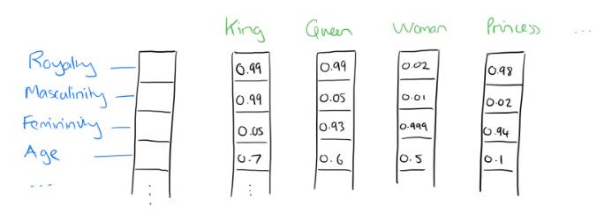
Distributional Representation: Illustration
If we label the dimensions in a hypothetical word vector (there are no such pre-assigned labels in the algorithm of course), it might look a bit like this:

Slide 9
Word Embeddings
d typically in the range 50 to 1000
Similar words should have similar embeddings

Slide 10
Reasoning with Word Vectors
It has been found that the learned word representations in fact capture meaningful syntactic and semantic regularities in a very simple way.
Specifically, the regularities are observed as constant vector offsets between pairs of words sharing a particular relationship.
Case of Singular-Plural Relations
If we denote the vector for word i as x_{i}, and focus on the singular/plural relation, we observe that
x_{apple} −x_{apples} ≈ x_{car} −x_{cars} ≈ x_{family} −x_{families} ≈ x_{car} −x_{cars} and so on.

Slide 11
Reasoning with Word Vectors
Perhaps more surprisingly, we find that this is also the case for a variety of semantic relations.
Good at answering analogy questions:
a is to b, as c is to ?
man is to woman as uncle is to ? (aunt)
A simple vector offset method based on cosine distance shows the relation.

Slide 12
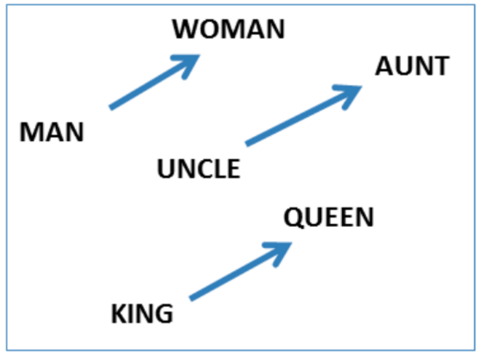
.

Slide 13
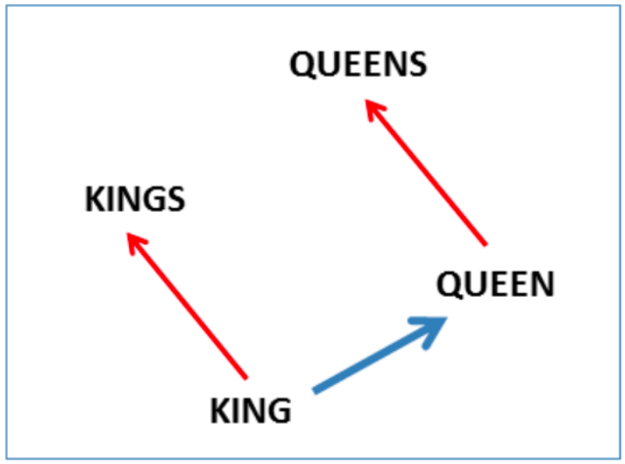

Slide 14
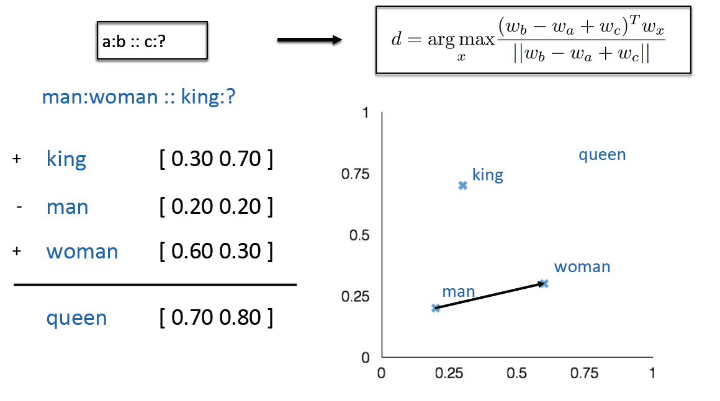
Analogy Test

Slide 15
Learning Word Vectors
Instead of capturing co-occurrence counts directly, predict (using) surrounding words of every word.
Code as well as word-vectors: https://code.google.com/p/word2vec/

Slide 16
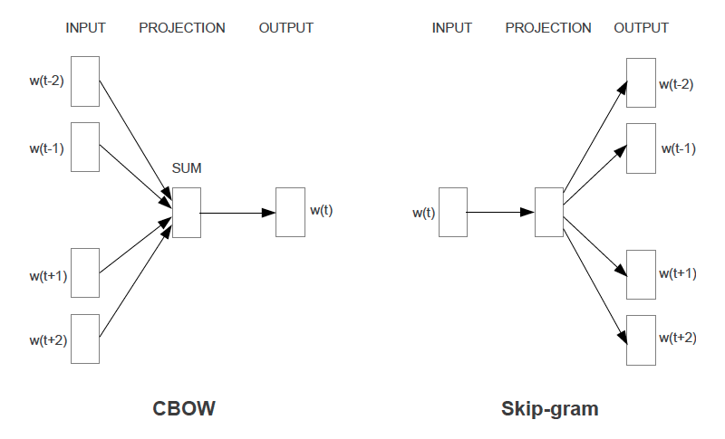
Two Variations: CBOW and Skip-grams

Slide 17
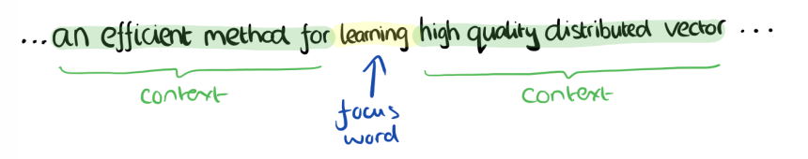
CBOW
Consider a piece of prose such as:
“The recently introduced continuous Skip-gram model is an efficient method for learning high-quality distributed vector representations that capture a large number of precises syntatic and semantic word relationships.”
Imagine a sliding window over the text, that includes the central word currently in focus, together with the four words that precede it, and the four words that follow it:

Slide 18
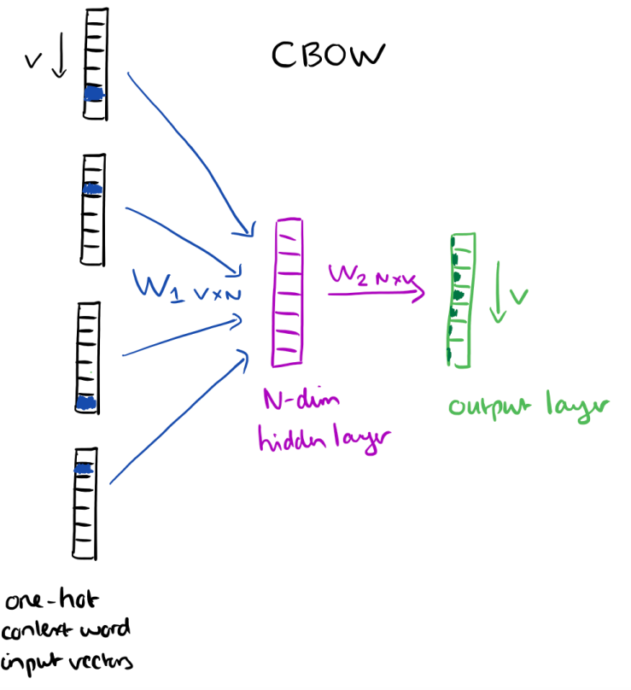
CBOW
The context words form the input layer. Each word is encoded in one-hot form.
A single hidden and output layer.

Slide 19
CBOW: Training Objective
The training objective is to maximize the conditional probability of observing the actual output word (the focus word) given the input context words, with regard to the weights.
In our example, given the input (“an”, “efficient”, “method”, “for”, “high”, “quality” , “distributed”, “vector”), we want to maximize the probability of getting “learning” as the output.

Slide 20
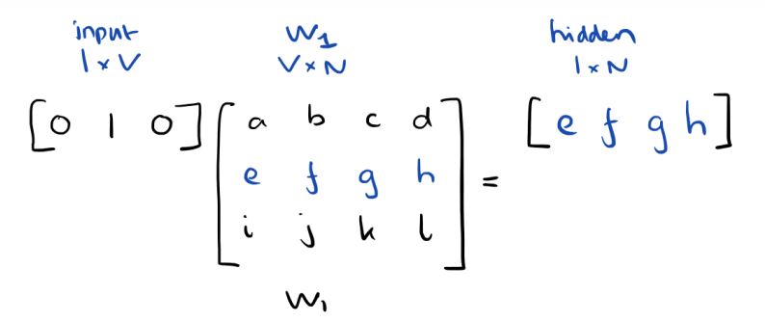
CBOW: Input to Hidden Layer
Since our input vectors are one-hot, multiplying an input vector by the weight matrix W₁ amounts to simply selecting a row from W₁.
Given C input word vectors, the activation function for the hidden layer h amounts to simply summing the corresponding ‘hot’ rows in W₁, and dividing by C to take their average.

Slide 21
CBOW: Hidden to Output Layer
From the hidden layer to the output layer, the second weight matrix W₂ can be used to compute a score for each word in the vocabulary, and softmax can be used to obtain the posterior distribution of words.

Slide 22
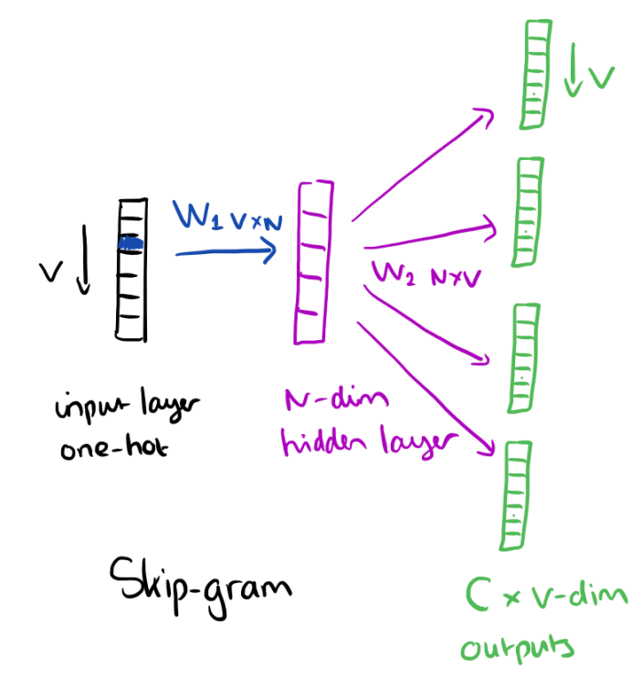
Skip-gram Model
The skip-gram model is the opposite of the CBOW model. It is constructed with the focus word as the single input vector, and the target context words are now at the output layer:

Slide 23
Skipgram : Objective Fn
The activation function for the hidden layer simply amounts to copying the corresponding row from the weights matrix W₁ (linear) as we saw before.
At the output layer, we now output C multinomial distributions instead of just one.
The training objective is to minimize the summed prediction error across all context words in the output layer. In our example, the input would be “learning”, and we hope to see (“an”, “efficient”, “method”, “for”, “high”,“quality”, “distributed”, “vector”) at the output layer.

Slide 24
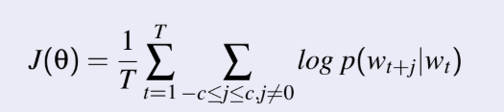
Skip-gram Model
Predict surrounding words in a window of length c of each word
Objective Function: Maximize the log probablility of any context word given
the current center word:

Slide 25
Thank You

